Slide 1
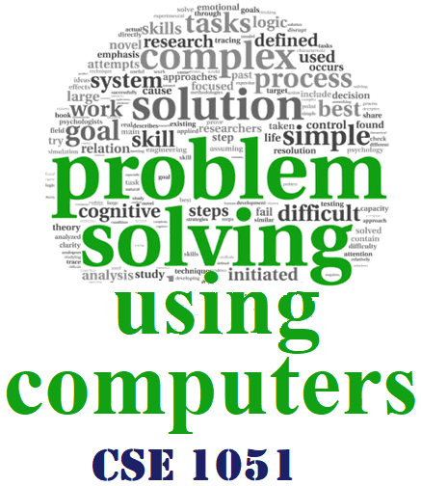

Introduction to the course

Slide 2
Opening remarks
Greetings
Importance of the course
Connection between the course and real world applications
Notes:
Importance of the Course:
Solving problems is the core of computer science. Programmers must first understand how a human solves a problem, then understand how to translate this "algorithm/logic" into something a computer can do, and finally how to "write" the specific syntax (required by a computer) to get the job done.
Given a problem, a computer scientist's goal is to develop an algorithm, a step-by-step list of instructions for solving any instance of the problem that might arise.

Slide 3
CSE-1051- Problem Solving Using Computers (PSUC)
Introduction to Computing (5 Hr)
C language – Types, operators, expressions and control flow (8 Hrs)
Arrays & Strings (8 Hrs)
Modular programming and Recursive functions (9 Hrs)
Advanced data types in C (Structures and Pointers) (6 Hrs)

Slide 4
Course Facilitation
PSUC Teaching Methodology
Power point presentation and Chalkboard
CSE 1051 (PSUC)
CSE 1061 (PSUC Lab)
PSUC CoursePlan (CSE1051)
Syllabus

Slide 5
Course Outcomes (PSUC 1501) - Theory
CO1: Explain basics of computing, use problem solving techniques to
solve simple problems using C language.
CO2: Use operators, decision making and looping constructs for
solving complex programs.
CO3: Understand and use derived data structures like arrays and
strings to solve higher level programs.
CO4: Understand and implement use of modular programming to
decompose a problem into functions and synthesize a complete
program.
CO5: Describe and use the derived data types like structures and
pointers and understand the importance of cyber security.
Assignments
End Semester Examination - 50%
Written examination of 3 hours duration

Slide 6
Course Outcomes (PSUC 1601) - Lab
CO1: Understand the basics of computing and operating systems,
formulate simple algorithms for arithmetic and logical problems,
translate the algorithms to programs, test and execute the
programs and correct syntax and logical errors.
CO2: To use arrays and pointers to formulate algorithms and simple
programs. Also apply programming to solve various matrix,
searching, sorting problems. Decompose a problem into
functions and synthesize a complete program using divide and
conquer approach. Implement recursive programming as
alternate method.
CO3: Apply the concept of structure and pointer programming,
understand and demonstrate the concepts of files and
MATLAB.

Slide 7
Assessment plan (Theory)
WILL BE INFORMED SOON

Slide 8
Assessment plan (Lab)
Continuous evaluation = 60 marks (A)
End Semester Exam = 40 marks (B)
Total = 100 marks (A+B)
Mandatory document requirements for lab:
Lab Manual &
Observation book

Slide 9
Best Practices
Appeal to move to the higher cognitive levels
Making reference/notes from prescribed text books/resources
Preparing own class notes
Discussion with peers and teacher
Punctuality and Presence (Attendance) in the class

Slide 10


